Slide 1




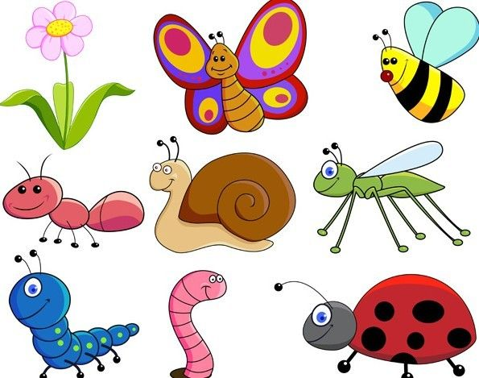
Nursery Parent Planner – Summer 1 2026
Vital vocabulary
Minibeast, insect, spider, caterpillar, butterfly, ladybirds, worms, bees, wing, cocoon, sting, legs, nectar, spots, antennae, patterns.
Quality questions
What is this minibeast?
Can it fly?
Does it have wings?
Where does it live?
Can you describe what they look like?
What is the same?
What is different?
Marvellous memories
Go on a Bug Hunt and identify different minibeasts
Make a wormery or a bug hotel and watch which minibeasts come to visit
Create an area to attract minibeasts in your garden and track what visits
People and places
Visit a local nature reserve and hunt for different minibeasts
Invite the Animal Man in to look at different minibeasts
Reliable reading
· The Very Busy Spider
· The Very Hungry Caterpillar
· Superworm
· The Bad Tempered Ladybird
· Bumblebear
Rewarding research
Spider creating a web— https://www.youtube.com/watch?v=L284iD585rQ
Caterpillar turning into a butterfly—https://www.youtube.com/watch?v=ocWgSgMGxOc
Fred Talk Games— fred_games.docx (live.com)
Don’t forget to upload pictures of your experiences to tapestry.
This terms theme:
What’s at the bottom of my garden?

Slide 2
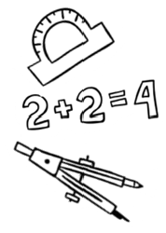


Nursery Parent Planner – Summer 1 2026
As Readers and Writers we will:
··Begin to tell own story and suggest how a story might end
· Begin to teach the first initial sounds in Read Write Inc (m,a,s,d,t) and introduce Fred Talking
· To form detailed drawings and begin to form the initial sound of their names
As Mathematicians this term we will:
·· To begin to touch count small amounts
· To begin to identify numbers 1-5
· Separate a group of 3 or 4 objects in different ways
To develop our physical skill we will….
We will...
· Begin to use our dominant hand when
using tools and use the non-dominant hand
to assist
· To begin using clay and dough to roll more accurate shapes
As communicators we will:
We will...
· Recall familiar stories and begin to create our own
· Begin to use longer sentences when talking
· Begin to understand simple 2 part instructions
· To begin to understand and answer simple questions such as ‘who’ and ‘where’
To help us understand the world around us we will...
· Identify different minibeasts
· know that minibeasts live in the garden
· know that our fruit peelings can be put into the compost
To develop our social and emotional skills we will:
We will...
· Begin to have the confidence to initiate play with others
· Begin to negotiate solutions to some conflict within their play
·
As Artists this term we will:
· Select colours for a purpose when creating pictures
· Confidently talk about our work we have created
· Take on unfamiliar roles such a being a minibeast

